Slide 1
CAPSTONE PROJECT
TEAM NAME : QuadARKS

Slide 2
Group-Members
202301154 - JAIN RUSHABHKUMAR SUNILKUMAR
202301087 - SHARMA AGRIM SARJU
202301033 - SHIVAM NARESHKUMAR PATEL
202301099 - KRISH MALHOTRA
Project-ID - P10
Github Link : https://github.com/agrimtdk/RecipeManager

Slide 3
The Recipe Manager

Slide 4
CONTENTS
PROBLEM STATEMENT
ALGORITHMS
DIAGRAMS
TIME
SPACE COMPLEXITY
VIDEO CODE RUNNING
DATA STRUCTURE CHOSEN

Slide 5
ALGORITHMS OF PROJECT

Slide 6
PROBLEM STATEMENT

Slide 7
PROBLEM STATEMENT
Build a recipe manager application where users can search, save, and organize recipes, including features like ingredient search, recipe categorization, and meal planning, utilizing data structures for recipe storage and retrieval.

Slide 8
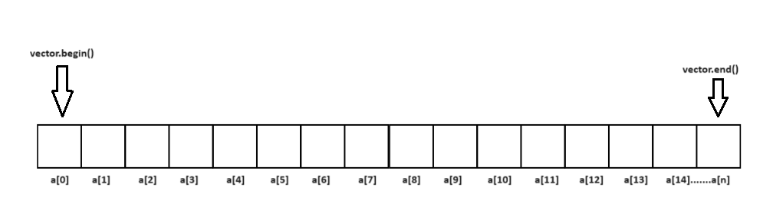
WE USE VECTOR FOR STORE RECIPE DETAILS

Slide 9
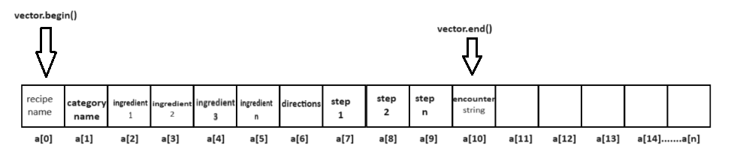
PARSED DATA TO VECTORS

Slide 10
ALGORITHM FOR RECIPE SEARCH FUNCTION
Input:
- Recipe name to search (recipe_name)
- File containing the recipes (file_name)
Procedure:
1. Open the file specified by file_name for reading.
2. If the file cannot be opened:
a. Print "Error: Unable to open file."
b. Exit the procedure.
3. While lines to read from the file:
a. Read the next line from the file.
b. Parse the line to extract the recipe details in vector.
c. If the extracted recipe name matches recipe_name:
i. Print the recipe details.
ii. Exit the loop.
4. If the recipe is not found:
a. Print "Recipe not found."
5. Close the file.

Slide 11
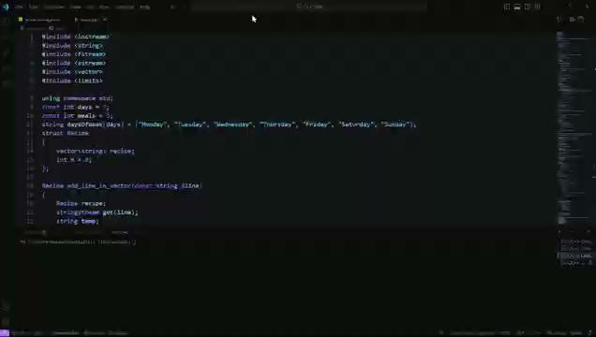
Video Representation
The following video contains the proper use case of the problem of meal planning through video representation done with help of Visual Studio Code along with powershell.

Slide 12
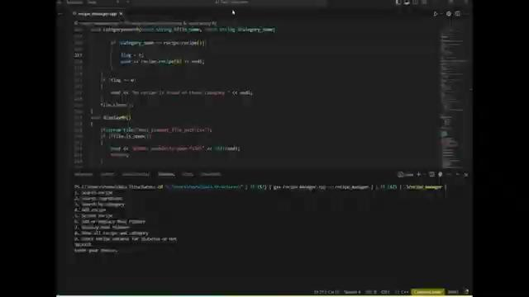
Video Representation
The following video shows the practical use of the program with the help of Visual Studio Code along with powershell.

Slide 13

DIAGRAMATIC REPRESENTATION OF VECTOR FOR RECIPE SEARCH FUNCTION
Compare the recipes name If recipe name matches print recipe with ingredient and steps.

Slide 14
TIME AND SPACE COMPLEXITY FOR RECIPE SEARCH FUNCTION
Time complexity
O(n * m), where n is the number of lines in the file and m is the average number of
ingredients in a recipe. Because it has to parse n lines of n recipes and m is the sum of
1(recipe name)+1(category)+x(ingredients)+x(directions).
Space complexity
Space Complexity: O(n) including vectors space for recipe details if excluding the
space for storing the recipe details then space complexity is O(1).

Slide 15
ALGORITHM FOR INGREDIENT SEARCH FUNCTION
Input:
- Ingredient name to search (ingredient_name)
- File containing the recipes (file_name)
Procedure:
1. Open the file specified by file_name for reading.
2. If the file not opened:
a. Print "Error: Unable to open file."
b. Exit the procedure.
3. Initialize a boolean variable found to false.
4. While there are lines to read from the file:
a. Read the next line from the file.
b. Parse the line to extract the recipe details.
c. For each ingredient in the extracted recipe:
i. If the ingredient matches ingredient_name:
- Print the name of the recipe.
- Set found to true.
d. Continue to the next recipe.
5. If no recipe contains the ingredient:
- Print "No recipe contains these ingredients."
6. Close the file.

Slide 16
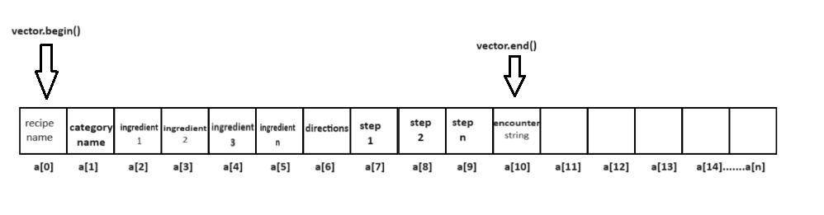

DIAGRAMATIC REPRESENTATION VECTOR
FOR INGREDIENT SEARCH FUNCTION
Compare with ingredient 1

Slide 17
DIAGRAMATIC REPRESENTATION VECTOR
FOR INGREDIENT SEARCH FUNCTION
Compare with ingredient 2

Slide 18
DIAGRAMATIC REPRESENTATION VECTOR
FOR INGREDIENT SEARCH FUNCTION
Compare with ingredient names up to n ingredient if matches then print recipes

Slide 19
TIME AND SPACE COMPLEXITY FOR INGREDIENT SEARCH FUNCTION
Time complexity
O(n * m), where n is the number of lines in the file and m is the average number of
ingredients in a recipe. Because it has to parse n lines of n recipes and m is the sum of
1(recipe name)+1(category)+x(ingredients)+x(directions).
Space complexity
Space Complexity: O(n) including vectors space for recipe details if excluding the
space for storing the recipe details then space complexity is O(1).

Slide 20
ALGORITHM FOR CATEGORY SEARCH FUNCTION
Input:
- Category name to search (category_name)
- File containing the recipes (file_name)
Procedure:
1. Open the file specified by file_name for reading.
2. If the file cannot be opened:
a. Print "Error: Unable to open file."
b. Exit the procedure.
3. Initialize a boolean variable found to false.
4. While there are lines to read from the file:
a. Read the next line from the file.
b. Parse the line to extract the recipe details.
c. If the category matches category_name:
i. Print the name of the recipe.
ii. Set found to true.
5. If no recipe is found in the specified category:
- Print "No recipe is found in this category."
6. Close the file.

Slide 21

DIAGRAMATIC REPRESENTATION VECTOR
FOR CATEGORY SEARCH FUNCTION
Compare with category name if category matches then print recipes

Slide 22
TIME AND SPACE COMPLEXITY FOR CATEGORY SEARCH FUNCTION
Time complexity
O(n * m), where n is the number of lines in the file and m is the average number of
ingredients in a recipe. Because it has to parse n lines of n recipes and m is the sum of
1(recipe name)+1(category)+x(ingredients)+x(directions).
Space complexity
Space Complexity: O(n) including vectors space for recipe details if excluding the
space for storing the recipe details then space complexity is O(1).

Slide 23
ALGORITHM FOR ADD MULTIPE RECIPE FUNCTION
Input:
- Recipe name (rec_add_name)
- Recipe type (rec_add_type)
- Recipe ingredients (rec_add_ing)
- Recipe steps (rec_add_steps)
- File to append recipe to (file_name)
Procedure:
1. Get the number of times to add the recipe (freq) from the user.
2. For each time to add the recipe:
a. tell the user to enter the recipe details:
- Recipe name
- Recipe type
- Recipe ingredients
- Recipe steps
b. Append the recipe details to the file in the specified format:
- rec_add_name,rec_add_type,rec_add_ing,directions,rec_add_steps
3. Close the file.

Slide 24
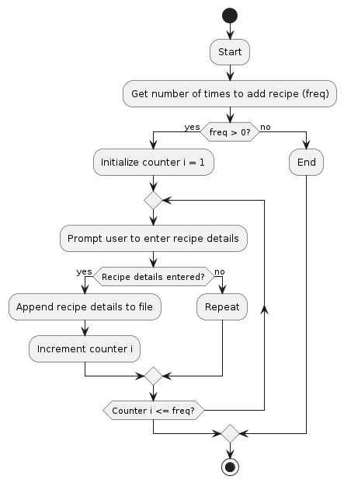
Flowchart to add multiple recipe

Slide 25
TIME AND SPACE COMPLEXITY FOR MULTIPLE ADD RECIPE FUNCTION
Time complexity
-- O(1) As the data is uploaded directly without explicit traversing, it has a constant time
complexity.
Space complexity
-- O(1) As the variable store limited data (only required) data, the function runs on
constant time complexity. Meaning we are not adding other data type explicitly on the
runtime.

Slide 26
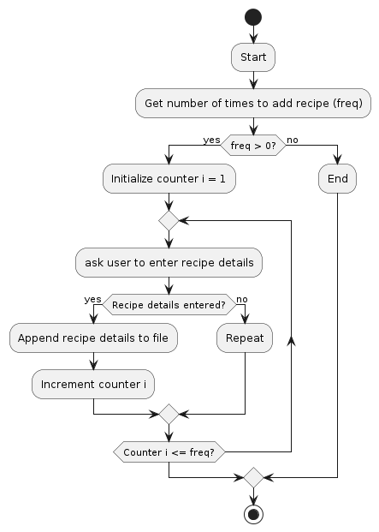

Slide 27
ALGORITHM FOR MULTIPE DELETE RECIPE FUNCTION
Input:
- Recipe name to delete (recipeNameToDelete)
- File containing the recipes (filename)
Procedure:
1. Open the file containing the recipes for reading.
2. If the file cannot be opened:
a. Print "Error: Unable to open file."
b. Exit the procedure.
3. Create an empty vector to hold the lines of the file.
4. While there are lines to read from the file:
a. Read the next line from the file.
b. If the line does not contain the recipe name to delete:
i. Add the line to the vector.
c. Otherwise, print "Recipe has been deleted."
5. Close the file.
6. Open the file for writing.
7. If the file cannot be opened for writing:
a. Print "Error: Unable to open file for writing."
b. Exit the procedure.
8. Write the lines from the vector back to the file.
9. Close the file.

Slide 28
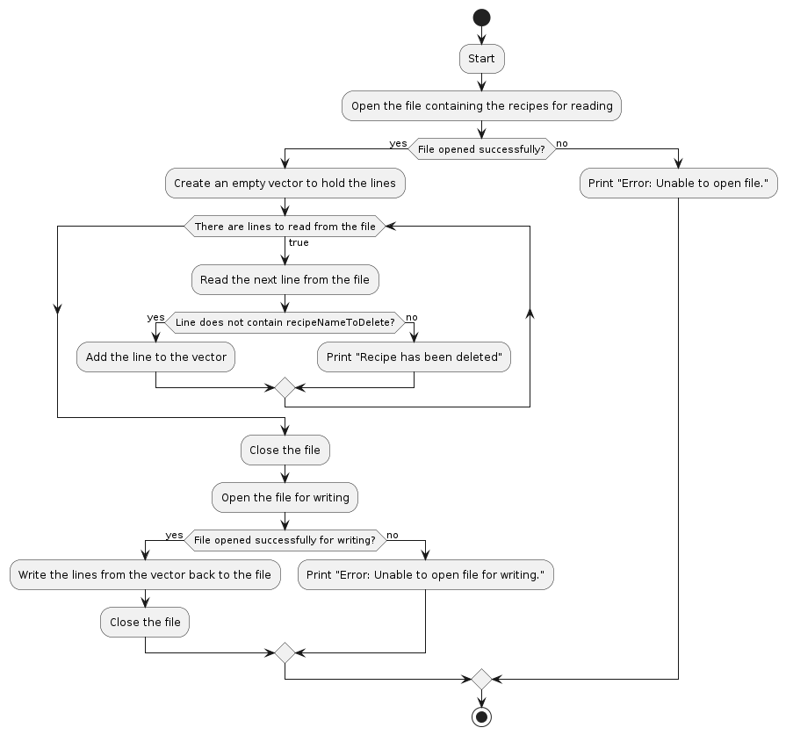

Slide 29
TIME AND SPACE COMPLEXITY FOR MULTIPLE DELETE RECIPE FUNCTION
Time complexity
-- O(n) As we have to search for particular recipe, in the worst case it may be found in
the last line, hence for considering n lines, it has complexity increasing with linear time.
Also, writing again takes linear time.
Space complexity
-- O(n) We have stored data with the help of vector, which again stores in line-wise
fashion. So, considering this it has linear space complexity.

Slide 30
ALGORITHM FOR ADD MEAL PLANNER FUNCTION
Input:
- Meal planner data (mealPlan), a 2D array containing meal details for each day
- File name to save the meal planner (file_name)
Procedure:
1. Open the file specified by file_name for writing.
2. If the file cannot be opened:
a. Print "Error: Unable to open file."
b. Exit the procedure.
3. Write the header line to the file: "Day,Meal".
4. For each day in the meal planner:
a. For each meal in the day:
i. Write the day index and meal details to the file in CSV format.
5. Close the file.
6. Print "Meal planner saved" to indicate successful completion.

Slide 31
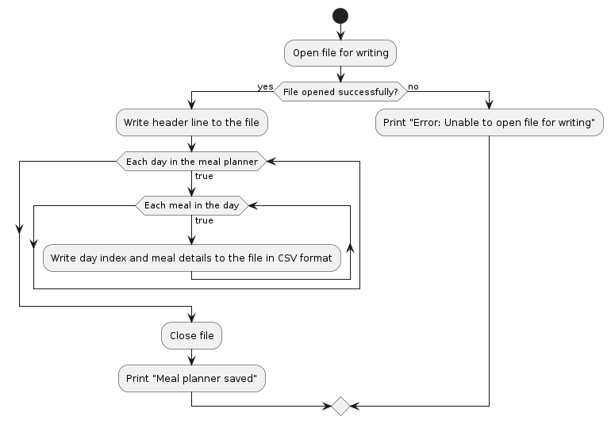

Slide 32
ADD MEAL OF DAYS
MEAL PLANNER
FOR SUNDAY
ENTER BREAKFAST:
ENTER LUNCH:
ENTER DINNER:
MEAL PLANNER
FOR MONDAY
ENTER BREAKFAST:
ENTER LUNCH:
ENTER DINNER:
MEAL PLANNER
FOR TUESDAY
ENTER BREAKFAST:
ENTER LUNCH:
ENTER DINNER:
MEAL PLANNER
FOR WEDNESDAY
ENTER BREAKFAST:
ENTER LUNCH:
ENTER DINNER:
MEAL PLANNER
FOR THURSDAY
ENTER BREAKFAST:
ENTER LUNCH:
ENTER DINNER:
MEAL PLANNER
FOR FRIDAY
ENTER BREAKFAST:
ENTER LUNCH:
ENTER DINNER:
MEAL PLANNER
FOR SATURDAY
ENTER BREAKFAST:
ENTER LUNCH:
ENTER DINNER:

Slide 33
TIME AND SPACE COMPLEXITY FOR ADD MEAL PLANNER FUNCTION
Time complexity
The saving to csv function will take a time for O(mxn) where m is days amd n are meals
Because in this function the user will enter meals for a day where the meals can be
empty or full
Space complexity
The arrays will be contributing the the space complexity where it will be O(mxn) where
m are days and n are meals.The space complexity of local variable in the function will
be O(1) And the space complexity of opening and editing the file will be O(1)

Slide 34
ALGORITHM FOR DISPLAY MEAL PLANNER FUNCTION
Input:
- File name of the CSV file containing the meal planner (file_name)
Procedure:
1. Open the file specified by file_name for reading.
2. If the file cannot be opened:
a. Print "Error: Unable to open file."
b. Exit the procedure.
3. Read and discard the header line from the file.
4. For each line in the file:
a. Read the next line from the file.
b. Split the line into fields using the CSV parsing method.
c. Print the day, meal type, and meal details.
5. Close the file.

Slide 35
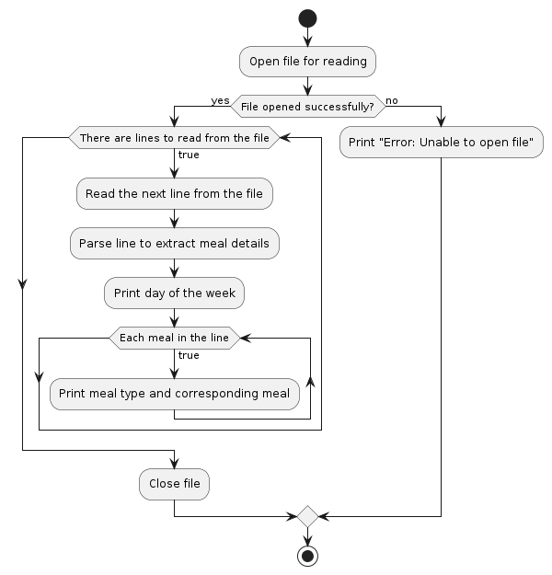

Slide 36
TIME AND SPACE COMPLEXITY FOR DISPLAY MEAL PLANNER FUNCTION
Time complexity
The display function will also take time O(mxn) where m is days amd n are meals
because it will be equal to the time of saving So if we see the overall time complexity
will be O(mxn)
Space complexity
Space complexity for display function is O(1).

Slide 37
ALGORITHM FOR RECIPE CATEGORY FUNCTION
Input:
- Category name to search (category_name)
- File containing the recipes (file_name)
Procedure:
1. Open the file specified by file_name for reading.
2. If the file cannot be opened:
a. Print "Error: Unable to open file."
b. Exit the procedure.
3. Initialize a boolean variable found to false.
4. While there are lines to read from the file:
a. Read the next line from the file.
b. Parse the line to extract the recipe details.
c. If the category matches category_name:
i. Print the name of the recipe.
ii. Set found to true.
5. If no recipe is found in the specified category:
- Print "No recipe is found in this category."
6. Close the file.

Slide 38
DIAGRAMATIC REPRESENTATION OF
RECIPE-CATEGORY SEARCH FUNCTION
Traverse all line of csv file and print recipe-category

Slide 39
TIME AND SPACE COMPLEXITY FOR RECIPE CATEGORY FUNCTION
Time complexity
O(n), where n is the number of lines in the file.because it has to traverse all lines.
Space complexity
Space Complexity: O(n) including vectors space for recipe details if excluding the
space for storing the recipe details then space complexity is O(1).

Slide 40
ALGORITHM FOR DIABETES EATABLES CHECK FUNCTION
Input:
- File containing the recipes (file_name)
- Recipe name to check (recipe_name)
Procedure:
1. Open the file specified by file_name for reading.
2. If the file cannot be opened:
a. Print "Error: Unable to open file."
b. Exit the procedure.
3. Initialize a boolean variable `flag` to 0.
4. While there are lines to read from the file:
a. Read the next line from the file.
b. Parse the line to extract the recipe details.
c. If the recipe name matches recipe_name:
i. Set flag to 1.
ii. Iterate over the ingredients of the recipe:
- If "sugar" is found in the ingredients:
- Set flag to 2.
5. If flag is 2:
a. Print "You can't eat [recipe_name] because of diabetes."
6. If flag is 1:
a. Print "You can eat [recipe_name]."
7. If flag is still 0:
a. Print "Recipe not found."
8. Close the file.

Slide 41
DIAGRAMATIC REPRESENTATION OF
DIABETES EATABLES CHECK FUNCTION
Check in ingredient if sugar is present then not eatable for diabetic

Slide 42
TIME AND SPACE COMPLEXITY FOR DIABETES EATABLES CHECK FUNCTION
Time complexity
O(n * (m+1)), where n is the number of lines in the file and m is the average number of
ingredients in a recipe. Because it has to parse n lines of n recipes and m is the sum of
1(recipe name)+1(category)+x(ingredients)+x(directions).and +1 for opening file
Space complexity
Space Complexity: O(n) including vectors space for storing recipe details if excluding
the space for storing the recipe details then space complexity is O(1).

Slide 43
Data Structure Chosen
Meal planner-
In the code of meal planner of the recipe manager the data structure used is a array,to be more specific a 2d array .the daysoftheweek array holds the number of a days in a week and the meals holds the meals such as breakfast lunch and dinner. Since the number of days in a week and the meals are considered to be constant ,2d array is suitable for this purpose
Why we used this DS-
Because we can have a array for the days of the week and also for the meals in a day ,a 2d array makes this task easy.A 2D array simplifies the representation of meal plans in the code compared to using separate arrays or other data structures.also it provides ease in iteration.

Slide 44
Recipe Data-
So in the part of the code of recipe data ,to organise it structures are used.he Recipe structure contains both a vector of strings (for variable-length ingredients and other details) and an integer m to count the number of ingredients. This structure provides a convenient way to encapsulate and manage recipe information as a single unit.
Why we used this DS-
In this we have used the above data structure because we can add recipe in the time complexity and space complexity of O(1),in deleting the time complexity is O(n).

Slide 45
To store Recipe And Ingredients-
To store the indregients and recipe details ,vectors are used in this case. Since the number of ingredients can vary ,vectors allows flexibility in managing the data.basically vectors can dynamically resize according to the deletion or addition in data .this makes easy to store variable lenght data
Why we used this DS-
As mentioned above vectors can dynamically resize,this provides flexibility in handling the data.Vectors handle memory management automatically. It also provides ease in insertion and deletion

Slide 46
Using of strings-
Strings are used in the code for storing textual data such as ingredient names, recipe names,file name,category name.strings provide a easy way to store and manipulate textual data.
File Handling-
File streams such as ifstream ofstream are used in the code to read from and to write in the file This allows the application to read recipe data from the file .also in the meal planner it is used to store the meal entered by the user

